Slide 1






Suite Dreams
Dorm Allocation Project
Kyren Stephenson, Alexes Pagan, Jonathan Fasano, Parsa Jafaripour, John Doyle, Arman Hemmati Alamdari

Slide 2

Problems
Inefficient
Roommate Incompatibility
Accessibility
Manual dorm room assignments are time-consuming and inefficient for college administrators.
Students often end up with incompatible roommates due to lack of personalized matching.
Existing processes struggle to accommodate student preferences and accessibility needs.

Slide 3
Background
Current systems rely on basic first come first serve methods or random assignments
When a student applies for a dorm room, the next or previous student would be their roommate
Limited or no consideration of student compatibility, leading to dissatisfaction.
When dorms are nearly filled, the next students would be placed into the next open dorm, possibly with a roommate there but the pair might not get along.
Existing software solutions lack automation and do not scale well with large student bodies.
When many students log in to existing software, the application might crash.

Slide 4

Our Solution
Matching Algorithm
Compatibility Scores
Enhancing Experience
An automated dorm allocation application using a sophisticated matching algorithm.
Personalized room and roommate assignments based on student preferences and compatibility scores.
Streamlines the assignment process, reducing administrative workload and enhancing student satisfaction.

Slide 5
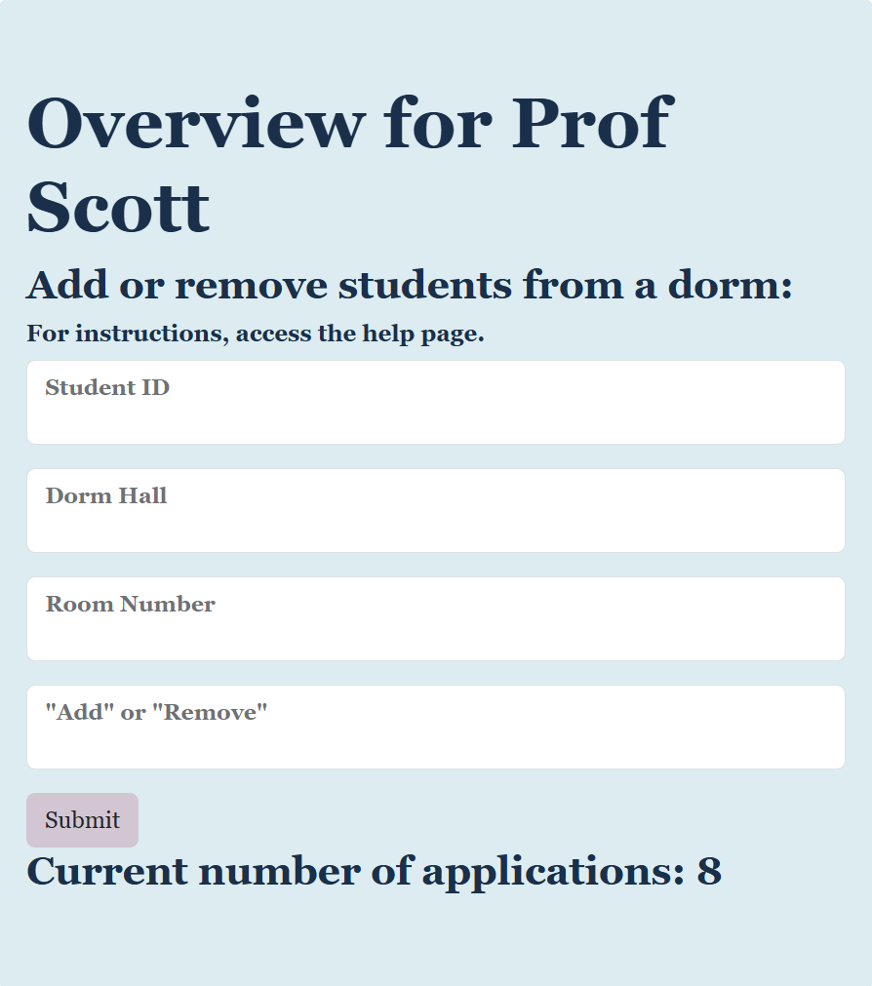
Project Goals
01
02
Develop a user friendly platform
Implement a robust matching algorithm
This allows for student to submit housing preferences and roommate requests
This will optimize room assignments based on
compatibility
03
04
Secure authentication and data management
Administration tools
Special access for monitoring occupancy and managing room assignments efficiently
With Firebase and Flask, security will be ensured for all students

Slide 6
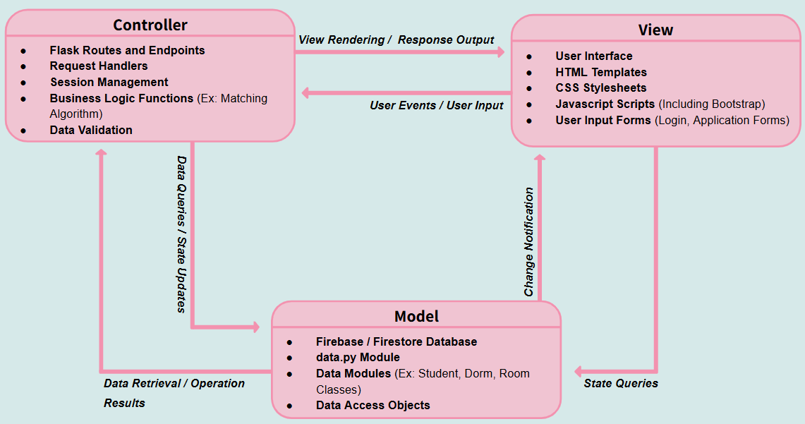
Project Design
01
MVC Architecture
Separated into Model, View, and Controller components for modularity
Model: Firebase/Firestore database and data access layer (data.py)
View: Frontend Interface using HTML, CSS, Javascript, and Bootstrap
Controller: Flask backend handling routing, logic, and communication between Model and View
02
Tools and Technologies
Firebase/Firestore: Database for storing user data and application information.
Flask: Framework for Backend development
Bootstrap: For responsive and user- friendly interface design
03
Design changes
Transitioned from a Layered Architecture to MVC for better alignment with our technologies
Enhanced the matching algorithm to include additional preferences and improve compatibility scoring

Slide 7
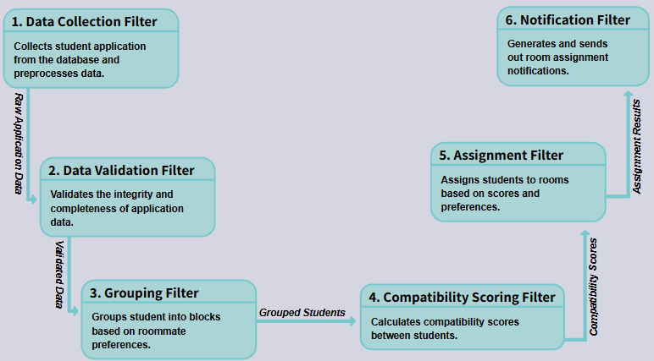
Methods
01
Matching Algorithm
Calculates compatibility scores using weighted student preferences
Processes both individual applications and roommate groups seamlessly
Incorporates error handling for missing or inconsistent data entries
02
Implementation Details
Developed in Python with integration to Firebase for real-time data access
Structured as a series of filters: data collection, validation, grouping, scoring, and assignment.
03
Testing Approach
Created diverse test cases to evaluate algorithm performance under various scenarios
Iteratively refined weights and thresholds based on test outcomes to optimize assignments

Slide 8
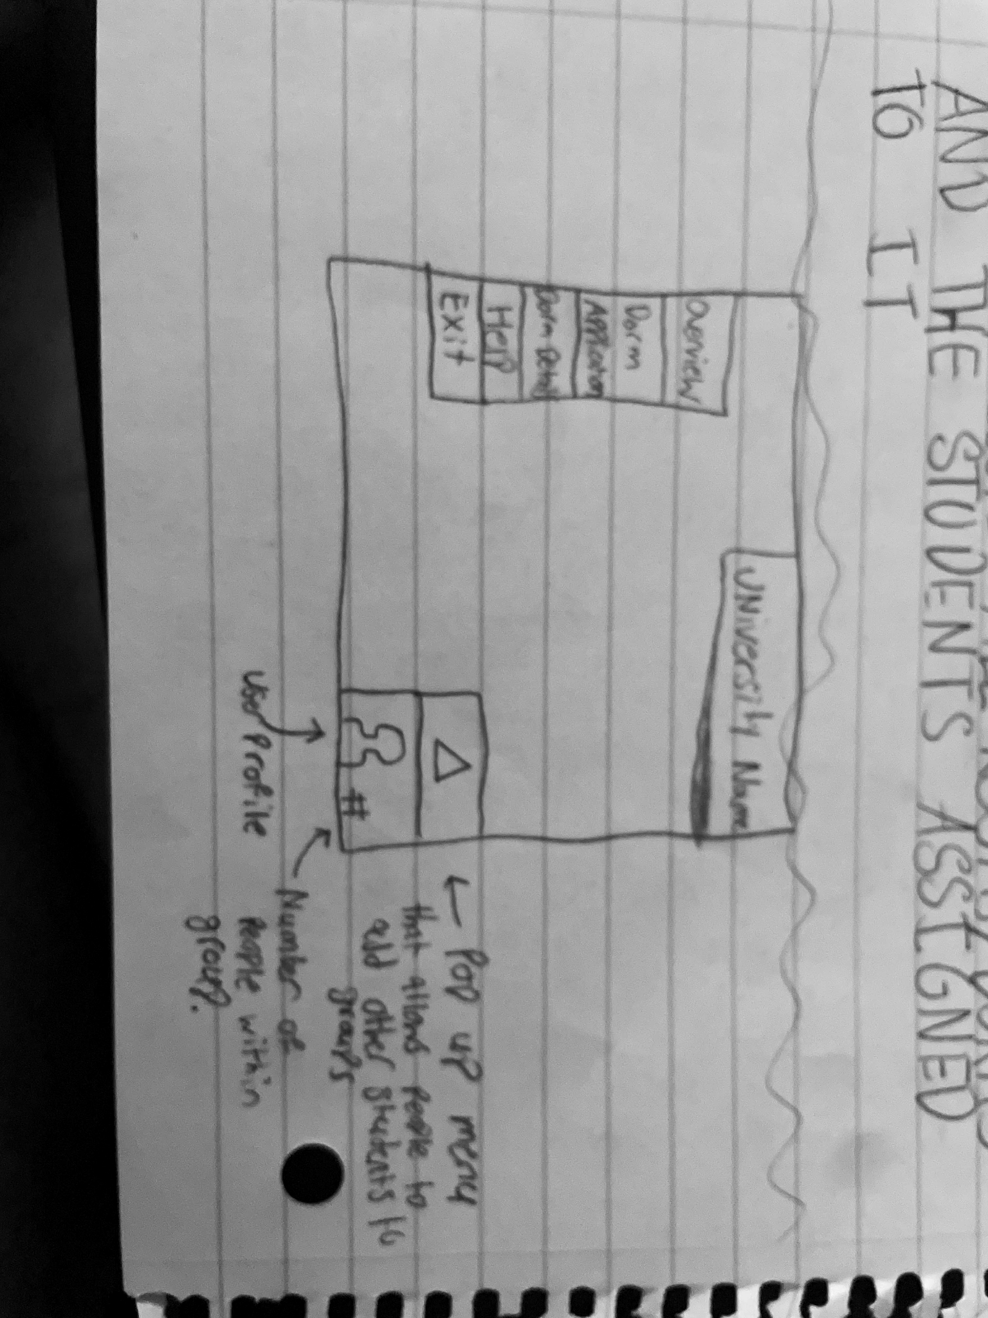
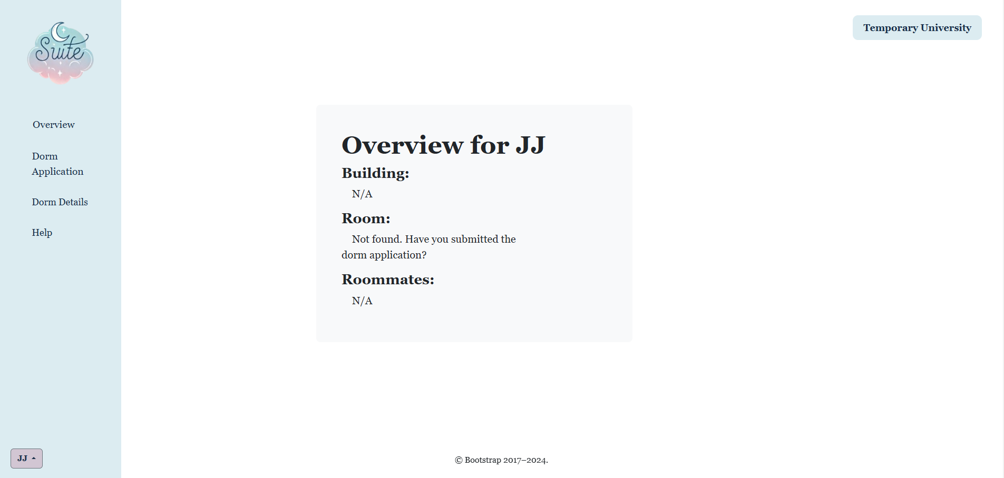
Project Implementation
01
Work Breakdown
Divided into sprints focusing on frontend, backend, database, and algorithm development.
Each sprint included planning, development, testing, and team reviews.
02
Team Member Contributions
Kyren Stephenson: Co-led frontend development and UI/UX design.
Jonathan Fasano: Co-led frontend development and UI/UX design.
Alexes Pagan: Managed database schemas and Firebase interactions.
John Doyle: Assisted in frontend development, UI Design, and Handled testing strategies.
Arman Hemmati Alamdari: Assisted with login page backend development and flask implementation.
Parsa Jafaripour: Coordinated project management, developed and optimized the matching algorithm.
03
Challenges Faced
Integrating Firebase Authentication with Flask sessions posed initial difficulties
Handling complex roommate grouping logic within the algorithm
Synchronizing team efforts across different schedules
Coding in new languages and frameworks (HTML, Javascript, Flask)

Slide 9

Testing
Strategies and Methods
Test Data and Cases
Results
Employed unit tests for individual functions and components
Conducted integration tests to make sure of smooth interaction between modules
Generated sample applications with varied preferences and roommate requests
Included edge cases like conflicting roommate choices and incomplete forms
Identified and resolved bugs affecting compatibility calculations
Validated that the algorithm assigns students effectively according to preferences
Achieved improved reliability and accuracy in room assignments through iterative testing.

Slide 10



Risks and Challenges
Adjustments Made
Reasons for Changes
Mitigation Actions
Adopted the MVC architecture to better suit our development framework.
Extended project timelines to address integration and testing complexities.
Original architecture didn't fully leverage the capabilities of Flask and Firebase.
Unanticipated technical challenges required reallocating resources and time.
Enhanced team communication and re-prioritized tasks to stay on track.

Slide 11
Team Experience
Teamwork Dynamics
Held regular virtual meetings for planning, progress updates, and troubleshooting.
Practiced code reviews and pair programming to enhance code quality and knowledge sharing.
Rules and Responsibilities
Clear delegation of tasks based on individual strengths and expertise.
Encouraged support among team members.
Project Management
Followed Agile principles with iterative development cycles.
Maintained documentation and meeting minutes to ensure transparency and accountability.

Slide 12
Conclusions
Achievements
Successfully delivered a functional application that automates dorm and roommate assignments.
Improved the dorm allocation process, making it more efficient and user-centric
Learning Outcomes
Gained practical experience in applying software engineering concepts to a real-world project.
Learned the importance of adaptability, especially when addressing unforeseen challenges.
Enhanced skills in teamwork, communication, and using modern development tools and frameworks.

Slide 13
Thank you!

